Slide 1
Digestive System
Year 11 Human Biology
ATAR
PowerPoint #11

Slide 2
SCSA Syllabus Reference
the supply of nutrients in a form that can be used in cells is facilitated by the structure and function of the digestive system at the cell, tissue and organ levels
digestion involves the breakdown of large molecules to smaller ones by mechanical digestion (teeth, bile and peristalsis) and chemical digestion (by enzymes with distinctive operating conditions and functions that are located in different sections of the digestive system)
the salivary glands, pancreas, liver and gall bladder produce or store secretions which aid the processes of digestion
absorption requires nutrients to be in a form that can cross cell membranes into the blood or lymph and occurs at different locations, including the small intestine and large intestine
elimination removes undigested materials and some metabolic wastes from the body

Slide 3
Lesson Intention
To distinguish between mechanical and chemical digestion
To explore the structure and function of the digestive system
To explore the effect of diet on the alimentary canal

Slide 4
Success Criteria
identify the different types of digestion
describe the process of mechanical digestion and where it occurs in the body
describe the process of chemical digestion and where it occurs in the body
identify the different types of digestion
describe the process of mechanical digestion and where it occurs in the body
describe the process of chemical digestion and where it occurs in the body

Slide 5
Success Criteria
identify the organs that make up the digestive system
recall the function of the digestive system organs
describe the structure of the digestive system organs
recognise that nutrient supply is needed at cell, tissue and organ levels
explain the process of nutrient absorption
construct a labelled diagram of a microvilli (fig 6.15 pg 151)
explain how the large intestine absorbs water

Slide 6
Success Criteria
identify different digestive conditions caused by diet
describe the conditions and their effects on the digestive system
recognise that changes to diet can reverse/improve the health of the alimentary canal
explain the importance of soluble fibre in the diet of a human being

Slide 7
Vocabulary
Mechanical digestion: the mechanical breakdown of food into small particles
Chemical digestion: the breakdown of food to small molecules by chemicals
Saliva: a fluid secreted into the mouth by salivary glands to begin digestion of food
Oesophagus: the tube that carries food from the throat to the stomach

Slide 8
Vocabulary
Peristalsis: waves of muscular contraction that push food along the alimentary canal
Stomach: a muscular organ that receives food from the oesophagus, and mixes it with acid and enzymes to form chime
Pyloric sphincter: a ring of smooth muscle between the stomach and the duodenum
Small intestine: the longest part of the alimentary canal; receives material from the stomach

Slide 9
Vocabulary
Bile: a secretion of the liver, stored in the gall bladder and released into the small intestine
Intestinal juice: the digestive juice secreted by the glands of the small intestine
Villi: projections from the internal lining of the small intestine
Microvilli: microscopic projections from the membranes of cells lining the small intestine. They increase the surface area for absorption.

Slide 10
Vocabulary
Lacteal: a lymph capillary in the small intestine. It absorbs fat from digested food.
Large Intestine: the part of the intestine between the small intestine and the anus.
Elimination: removal of indigestible material, bacteria and bile pigments from the body

Slide 11
Vocabulary
Constipation: a condition in which defecation is difficult, with faeces being hard and dry
Diarrhoea: the frequent passing of watery faeces
Coeliac disease: an autoimmune disease due to the immune system reacting to gluten.

Slide 12
Types of Digestion- Mechanical
Digestion is the process of breaking down food into particles small enough to be absorbed into the bloodstream.
Mechanical digestion is the PHYSICAL breakdown of food. It involves:
The teeth cutting, tearing and grinding the food
Churning action in the stomach breaking the food down further
The gall bladder releasing bile into the small intestine. The bile salts act as emulsifying agents, breaking down fat into smaller droplets.

Slide 13
Types of Digestion- Chemical
Chemicals break down large, complex molecules into smaller, simpler molecules.
These smaller molecules are then small enough to be absorbed into the bloodstream.
Chemical digestion is achieved by enzymes.

Slide 14
The Alimentary Canal
Continuous tube that runs from the mouth to the anus. Makes up the digestive system.
The lining of the alimentary canal is the surface through which nutrients are absorbed.

Slide 15
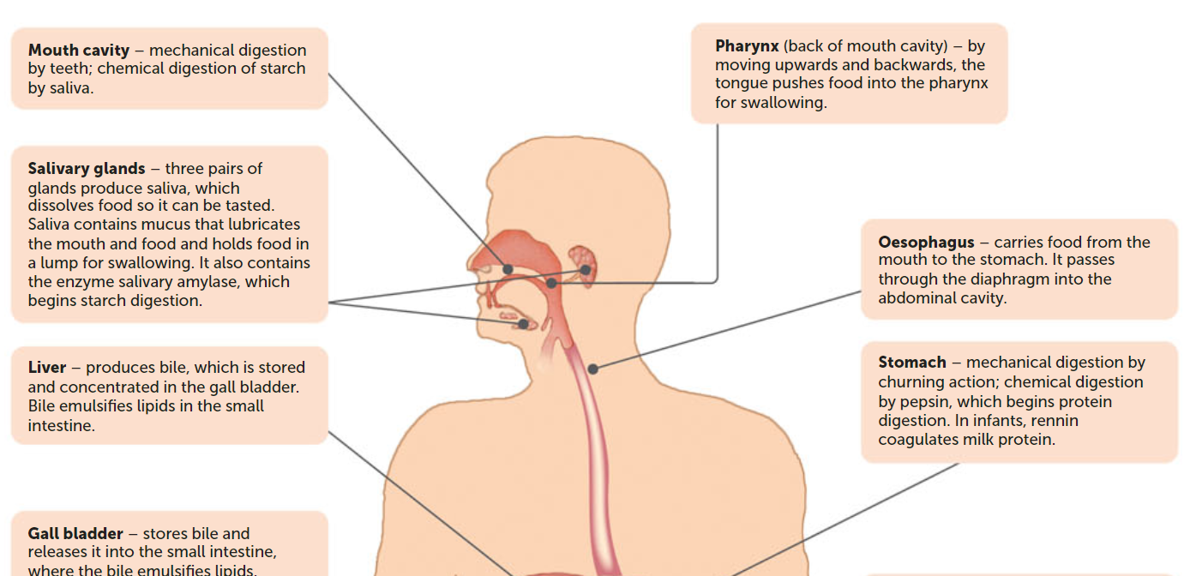

Slide 16
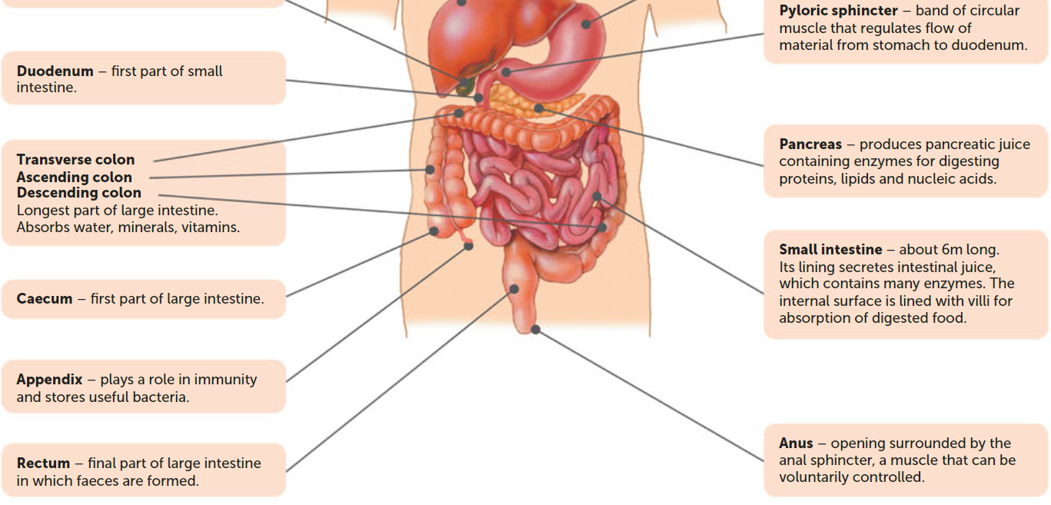

Slide 17
The Mouth
Saliva and chemical digestion
Saliva contains mucus to lubricate the food and a digestive enzyme called salivary amylase (for starch)
Teeth
Mechanical digestion.
Has incisors (for cutting), canines (for tearing), premolars and molars (crushing and grinding)
After chewing, food is known as a bolus.

Slide 18
The oesophagus
About 23-25 cm long that connects the pharynx to the stomach.
Double layer of muscle. The circular muscle has muscle fibres arranged in a circle and the longitudinal fibres has fibres arranged along the length of the canal.
As the lump of food enters the oesophagus, the circular muscle behind it contracts to narrow the tube. The contraction of successive bands of circular muscle causes the constriction to move in a wave called peristalsis. This movement pushes the food in front of it.

Slide 19
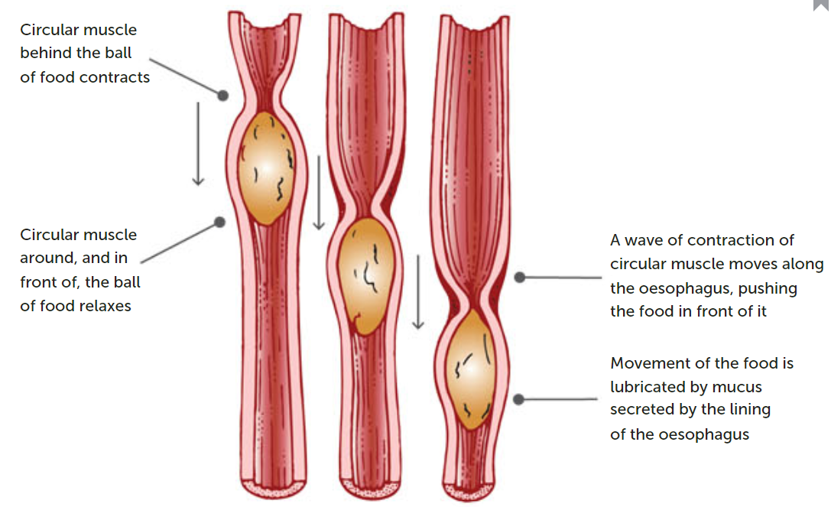

Slide 20
The stomach
Mechanical digestion in the stomach is achieved by waves of muscular contraction that move along the stomach wall.
Unlike the rest of the alimentary canal, the stomach has an oblique muscle layer as well as a circular and longitudinal layer. This enables the stomach to contract in a variety of ways to churn the food and mix it with the stomach juices until the food is converted to a thick, soupy liquid called chyme.

Slide 21
The stomach continued.
The lining of the stomach, the mucosa, is specialised for the secretion of gastric juice by gastric glands.
Gastric juice is a digestive juice containing hydrochloric acid, mucus, and digestive enzymes. Each of these is secreted by a different type of cell.
The pH of the stomach is approximately 2-3. The cells lining the stomach are protected from the acid by a layer of mucus.

Slide 22
The stomach continued.
Nutrients are not absorbed into the bloodstream through the stomach, because the internal surface is covered by a thick layer of mucus. However, some alcohol and a few other drugs such as aspirin are absorbed.
At the lower end of the stomach there is a pyloric sphincter. This prevents the stomach contents from moving through unless pushed along by peristalsis. After 2 to 8 hours, the stomach contents are gradually pushed into the small intestine.

Slide 23
The small intestine
Longest part of the alimentary canal, at approximately 6-7m in length. It receives material pushed through the pyloric sphincter from the stomach.
It has three regions
Duodenum: short (25 cm), curves around pancreas, most of the chemical digestion occurs here.
Jejunum: middle section, allows for effective absorption of carbohydrates and proteins
Ileum: final part, vitamin B12, bile salts and any remaining products of digestion are absorbed.

Slide 24
Small Intestine continued.
Digestion continues in the small intestine under the influence of:
Pancreatic juice- secreted by the pancreas via the pancreatic dust
Bile- produced by the liver, but stored in the gall bladder and secreted into the small intestine via the bile duct
Intestinal juice- secreted by glands in the lining of the small intestine.

Slide 25
Pancreatic Juice
Enters the duodenum through the common bile duct. It helps to neutralise the acid that comes through with the chyme and contains many of the enzymes involved in the digestion of food. The enzymes include:
Pancreatic amylase- starch into disaccharide maltose
Trypsin – proteins into peptides
Pancreatic lipases- fats into fatty acids and glycerol
Ribonuclease and deoxyribonuclease- enzymes that digest RNA and DNA

Slide 26
Bile
Secreted into the small intestine by the common bile duct
Doesn’t contain any digestive enzymes, bile salts are very important in the mechanical digestion of fats.
They act like a detergent and emulsify the fat, breaking into tiny droplets (form of mechanical digestion).

Slide 27
Intestinal juice
Contains many enzymes that complete the digestion of carbohydrates, proteins and lipids. These include:
Peptidase to break down peptides into amino acids
Sucrase, lactase and maltase to break down sucrose, lactose, and maltose into monosaccharides
Lipases to break down lipids into fatty acids and glycerol.
Mechanical digestion also continues in the small intestine through a process called segmentation. Contractions of the circular muscles narrow the intestine which helps break up the bolus and mix it with the juices and bile.

Slide 28
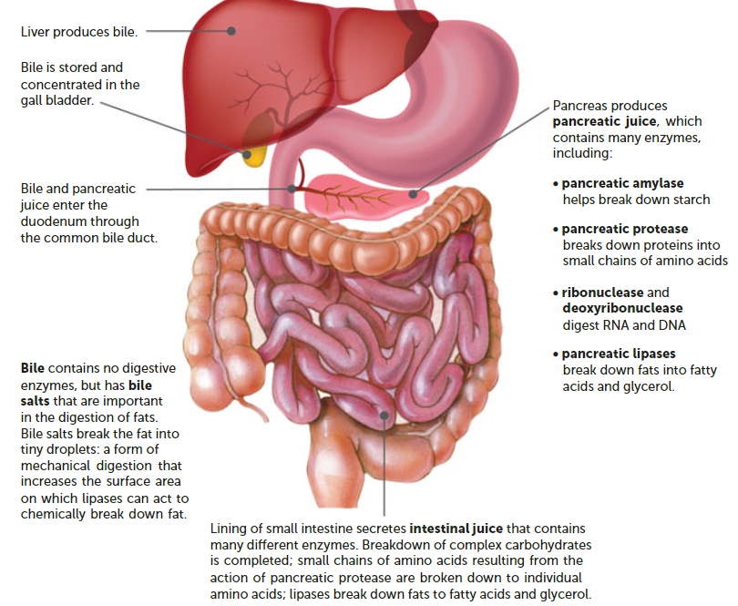

Slide 29
Absorption of nutrients
When chemical digestion is complete, the complex carbohydrates will have been broken down into simple sugars, the proteins into amino acids, and the fats into fatty acids and glycerol.
These are absorbed along with substances such as vitamins, minerals and water through the wall of the small intestine into the blood.
Nutrients are absorbed through the internal wall of the small intestine, so efficient absorption needs a large surface area

Slide 30
Surface area in Small Intestines
This is achieved by
Length (about 6-7m long)
The inner lining (mucosa) has folds that extend into the interior of the small intestine
The mucosa has small, finger-like projections called villi that extend from the folded surface
The cells covering the outside of the villi have tiny microscopic projections from their external surfaces. These are the microvilli

Slide 31
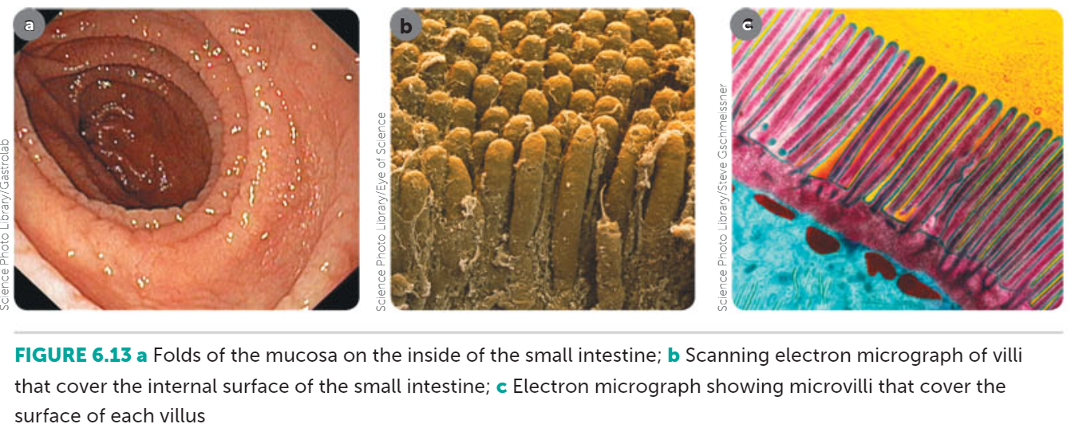

Slide 32
Villi
The structure of a villus is ideally suited to its function of nutrient absorption
Each villus is about 1 mm long and covered by a single layer of cells. Inside the villus is a lymph capillary, called a lacteal, which is surrounded by a network of blood capillaries.
Absorption is further enhanced by continual movement of the villi brought about by the muscular movements of the intestinal wall.

Slide 33
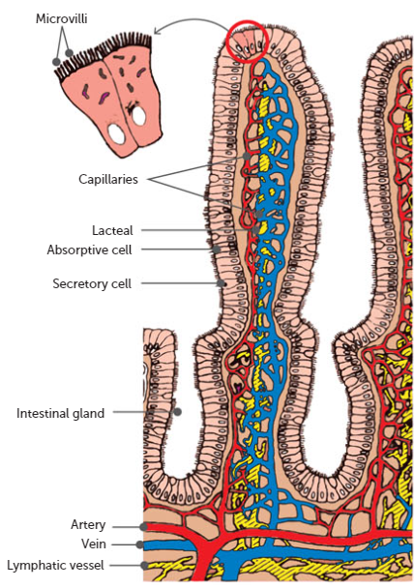

Slide 34
Absorption
Some absorption occurs through simple diffusion, as there is a higher concentration of nutrient materials in the interior of the small intestine than in the cells lining the villi.
Absorption also occurs through active transport

Slide 35
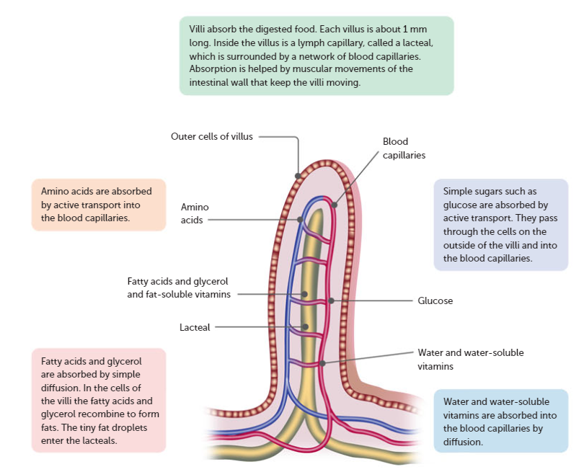

Slide 36
Absorption continued
From the villi walls, substances are absorbed into the blood capillaries.
Fatty acids and glycerol recombine in the villi cells to form fats and enter the lacteals.
The substances that absorbed into the blood capillaries are carried by the hepatic portal vein to the liver for further processing.

Slide 37
The large intestine
About 1.5 m long and larger in diameter than the small intestine.
Made up of the caecum, appendix, colon, rectum and anus.
Lining secretes a large amount of mucus and the movement of material through the large intestine is fairly slow (18-24 hours) to pass through. During this time, most of the remaining water is absorbed.

Slide 38
The large intestine continued.
Bacteria in the large intestine breaks down much of the remaining organic compounds. Some bacteria produce vitamins, which are then absorbed. Mineral nutrients are also absorbed.
The semi-solid material left makes up the faeces, which contain water, undigested food material, bacteria, bile pigments, and remains of cells.
The faeces pass through the rectum and anus to the exterior of the body

Slide 39
Constipation
Occurs if the movement of the large intestine are reduced and the contents remain there for a long period of time.
As water is absorbed, the faeces become drier, harder and more painful to pass.
Constipation may be caused by lack of roughage (cellulose) in the diet or exercise or emotional problems.

Slide 40
Diarrhoea
Characterised by the frequent defecation of watery faeces. It is caused by irritation of the small or large intestine, which increases peristalsis so that the contents of the intestines move through before there is adequate absorption of water.
This can be the result of a bacteria, virus, parasite, cancer (bowel cancer), coeliac disease, and lactose intolerance.
If the diarrhoea is severe, it may lead to dehydration through loss of water from the intestines, and may even cause death.

Slide 41
Soluble fibre in the diet
Both soluble and insoluble fibre are only found in food that comes from plants.
Good sources of soluble fibres are fruits, vegetables, oat, bran, barley and soy products

Slide 42
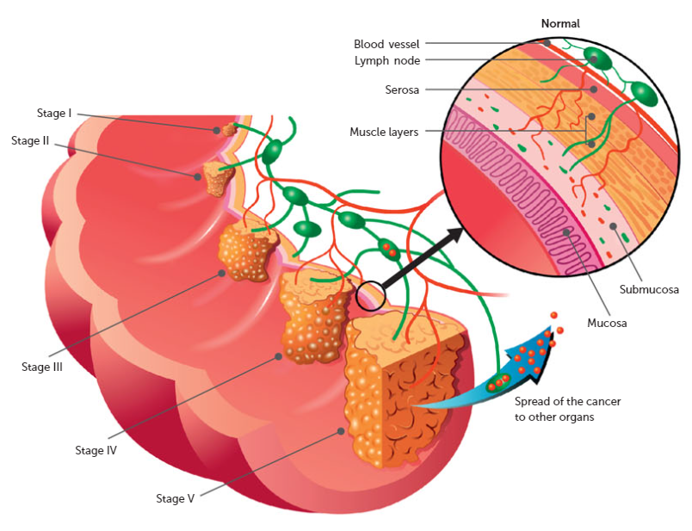
Bowel Cancer
Uncontrolled growth of cells in the wall of the large intestine.
Research shows links to diet, alcohol consumption and smoking

Slide 43
Coeliac Disease
Unable to tolerate gluten. If they eat gluten, their immune system responds by damaging or destroying the villi in the small intestine. It is inherited, there is no cure. Management is via gluten free diet
Without healthy villi, nutrients cannot be absorbed, and the person becomes malnourished no matter how much food they eat.
Symptoms can include muscle cramps, joint pain or tingling in the legs.

Slide 44
Recall Knowledge
Describe the purpose of digestion.
List the structures of the alimentary canal in order, starting from the mouth.
List the enzymes present in pancreatic juice.

Slide 45
Apply Knowledge
Explain the role of hydrochloric acid in the stomach
Explain why it is important for people to eat fruit and vegetables.

Slide 46
Homework
Absorption of nutrients depends of the concentration differences so that the substances diffuse across the absorbing surface. Explain how the concentration difference is maintained in the parts of the alimentary canal where absorption occurs.

Slide 47
Reading
Pages 142- 155: The digestive system chapter

